Slide 1


Consumer Goods Ad_Hoc Insights
Codebasics Resume Project Challenge #4
By Sudipta Vishwakarma

Slide 2
Objectives
As we all know data has become the necessary asset for any organisation. It helps
organisation to identify new opportunities, take smarter business moves, make
operations more efficient, can generate higher profits and to know more about the
pain areas.
Atli hardware is a Manufacturing company. Its Managing Director is facing a lot
of issues in taking prompt and wise decisions for further sales . He wants sales
insights detail and reports from the data .
To solve his problems he decided to run a SQL challenge. He provided us with
10 Ad hoc request.
we will solve this 10 Ad Hoc request by writing queries in SQL to extract the
output and take out the necessary insights.
Fiscal year 2020= September 2019-August2020 & Fiscal year 2021= September
2020-August2021
.

Slide 3

Atliq Hardware
* Atliq Hardware company Manufactures supplies computer hardware and peripherals to
many client across India.
Atliq’s Product Lines
PC
P & A
N & S
Peripherals
Accessories
Networking
Storage
Desktop
Network
Business Laptop
Gaming Laptop
Graphic card
Batteries
WIFI-Extender
External SSD
Internal HDD
Keyboard
Personal Laptop
Business Laptop
USB Flash Devices
Mother Board
Mouse
Personal
Laptop
Processor

Slide 4
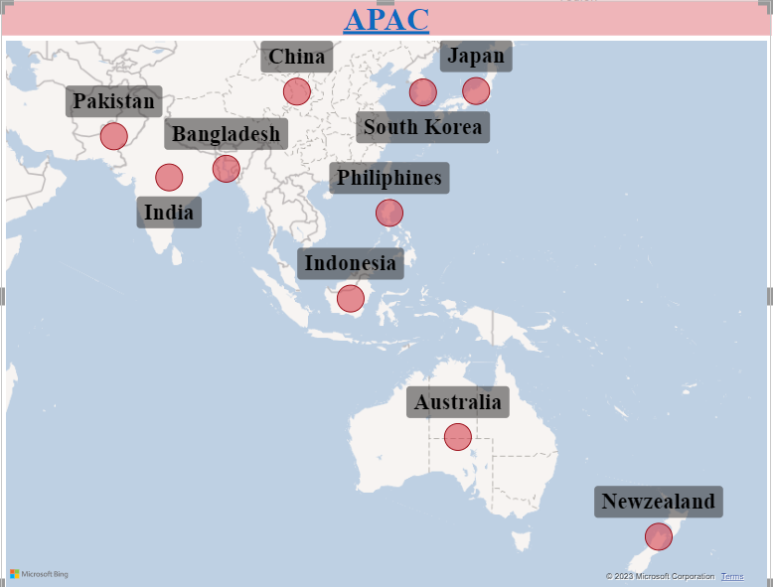
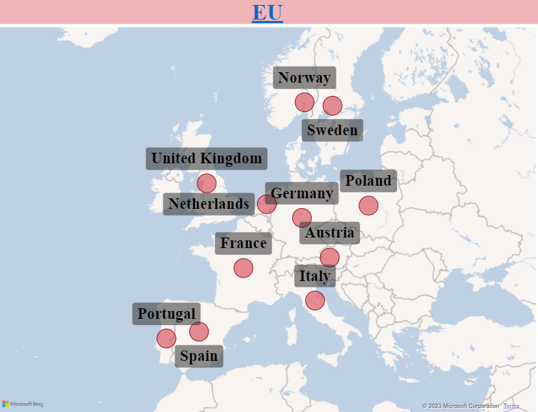
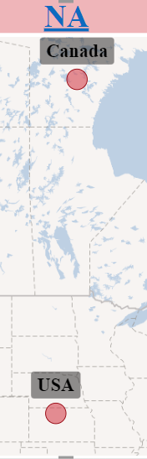
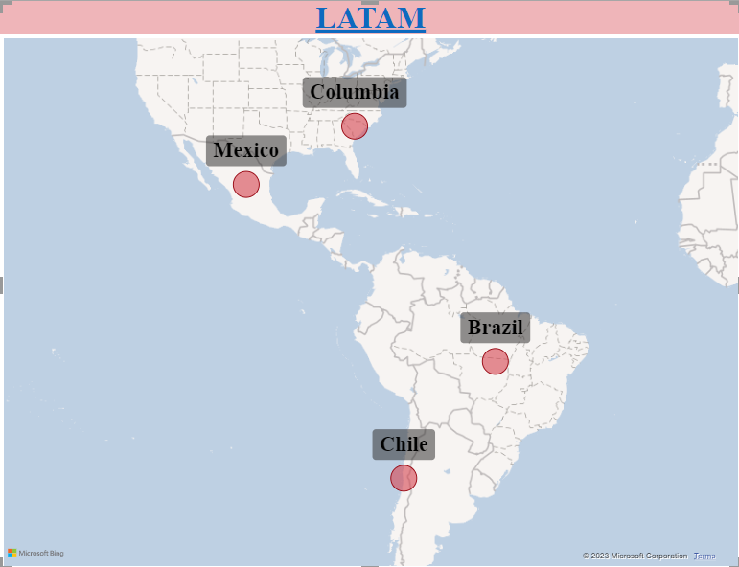
Atliq Hardware’s company market is widely spread in other region also

Slide 5

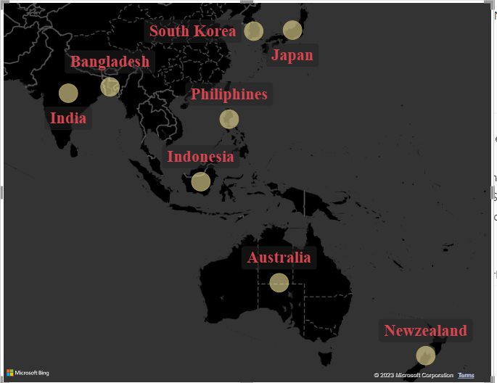

Provide the list of markets in which customer “Atliq Exclusive" operates its business in the APAC region.
Output
Query: Input
SELECT distinct(market) from dim_customer
where customer="Atliq Exclusive " and region="APAC“
Insight: Atliq Exclusive operates in 8 different markets in APAC Region

Slide 6

what is the percentage of unique product increase in 2021 vs. 2020? the final output contains these fields, unique_products_2020, unique_products_2021, percentage_chg
SQL Query- Input
with cte1 as
(SELECT count(distinct(product_code)) as Unique_por_2020
from fact_sales_monthly
where fiscal_year=2020),
cte2 as
(SELECT count(distinct(product_code)) as Unique_por_2021
from fact_sales_monthly
where fiscal_year=2021)
select Unique_por_2020,Unique_por_2021,
(unique_por_2021-Unique_por_2020)*100/Unique_por_2020 as Per_Chg
from cte1 cross join cte2
Output

Slide 7
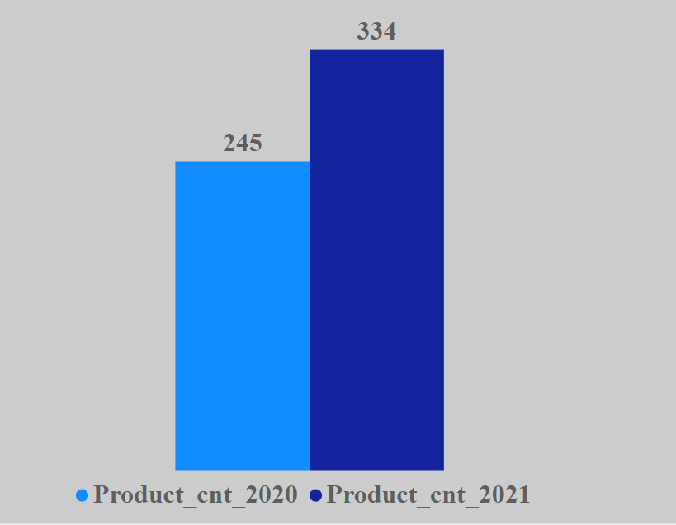
In FY 2020, we had a total of 245 products but in fY 2021, our count increased by 36% to 334 products. Because of the demand , production also increased.
36.32%
Insights

Slide 8
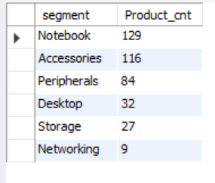
Provide a report with all the unique product counts for each segment and sort them in descending order of product counts. the final output contains 2 fields- Segment, Product_count.
Query- Input
SELECT segment,
count(distinct(product_code)) as Product_cnt from dim_product
group by segment
order by Product_cnt desc
Output

Slide 9
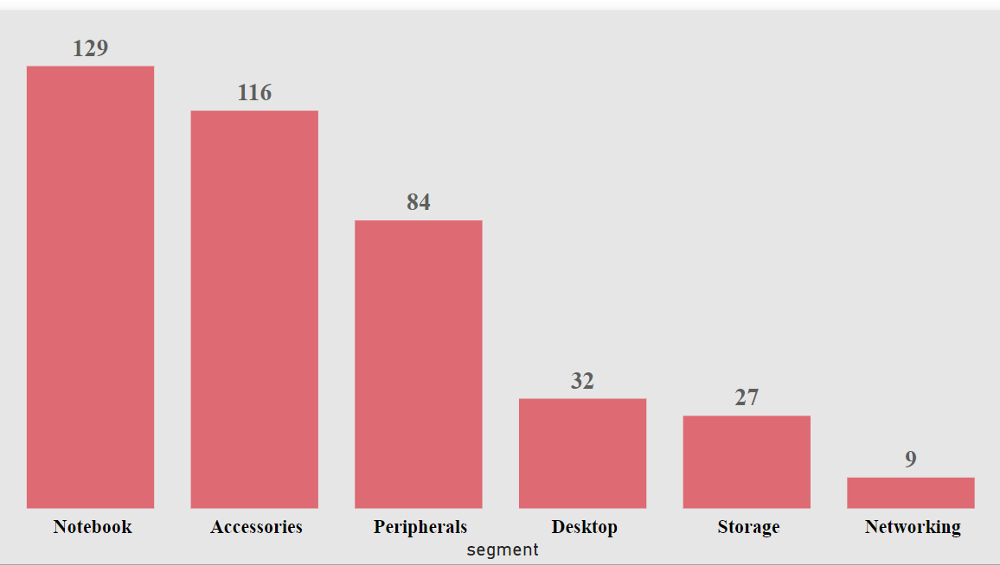
Notebooks, accessories and peripherals are showing significant manufacturing growth as compared to desktops, storage and networking. Notebooks, accessories and peripherals constitute 83% of the total manufactured products.
Insights

Slide 10
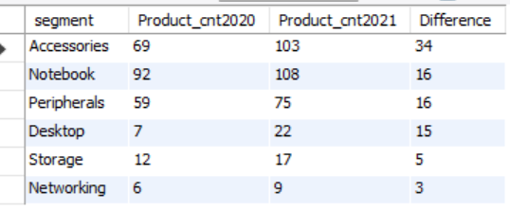
which segment had the most increase in unique products in 2021 vs 2020? the final output contains these fields Segment , Product_count_2020, Product_count_2021, Difference.
Query- Input
with cte1 as
(select distinctfsm.product_code,fiscal_year, segment
from dim_product dm join fact_sales_monthly fsm
on dm.product_code=fsm.product_code),
cte2 as
(select segment,count(product_code) as Product_cnt2021
from cte1 where fiscal_year=2021
group by segment
order by Product_cnt2021 desc),
cte3 as(select segment,count(product_code) as Product_cnt2020 from cte1
where fiscal_year=2020
group by segment
order by Product_cnt2020 desc)
select a.segment,Product_cnt2021,Product_cnt2020,(Product_cnt2021-Product_cnt2020) as Difference
from cte2 a
join cte3 bon a. segment=b.segment
order by Difference desc
Output

Slide 11
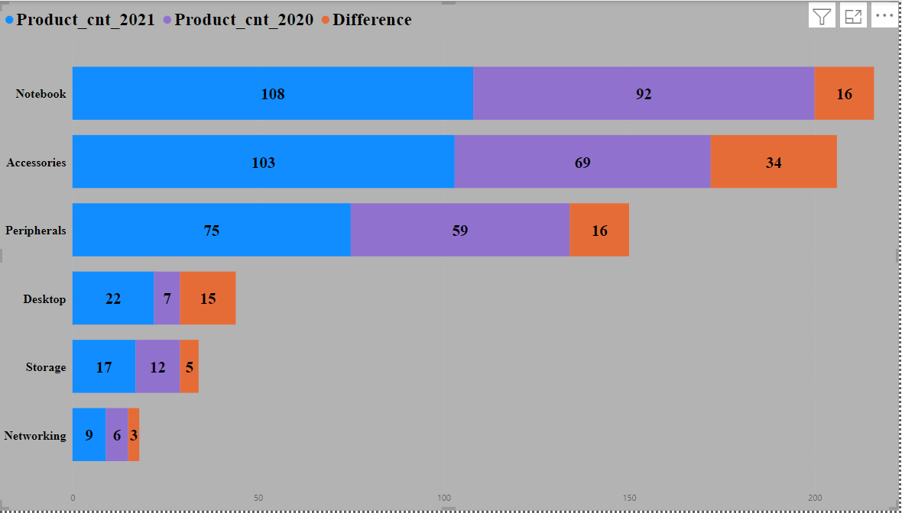
Accessories has the most increase in unique product in 2021 vs 2020. Notebook, peripherals and desktop has also a good growth in unique products Whereas storage and networking are experiencing slower production growth than other segments.
Insights

Slide 12

get the products that have the highest and lowest manufacturing costs. the final output should contain these fields product code, product, manufacturing cost
output
SQL-Input
SELECT fmc.product_code,product,
manufacturing_cost,segment
FROM fact_manufacturing_cost fmc
join dim_product dp
on fmc.product_code=dp.product_code
where manufacturing_cost in((select min(manufacturing_cost)
from fact_manufacturing_cost),
(select max(manufacturing_cost) from fact_manufacturing_cost))

Slide 13
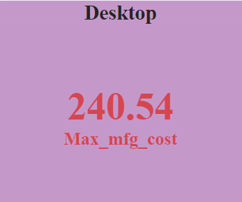
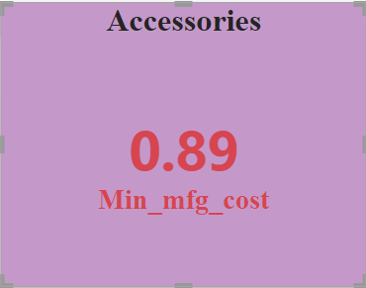


Mouse: AQ master wired x1 Ms has the lowest manufacturing cost Personal desktop: AQ home ALLIN1 Gen2 has the highest manufacturing cost
Insights

Slide 14
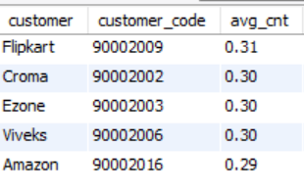
Generate a report which contains the top 5 customers who received an average high pre_invoice_discount_pct for the fiscal year 2021 and in the Indian market. the final output contains these fields customer code, customer , average discount percentage
SQL Input
with cte1 as
(SELECT customer_code,round(avg(pre_invoice_discount_pct),2) as avg_cnt
FROM fact_pre_invoice_deductions
where fiscal_year=2021
group by customer_code)
select customer,ct.customer_code,avg_cnt,market from cte1 ct
join dim_customer dmon ct.customer_code=dm.customer_code
where market="India"order by avg_cnt desc limit 5

Slide 15
The largest average pre-invoice discount was given to flipkart the least average pre-invoice discount was given to amazon
Insights

Slide 16
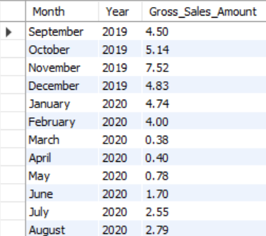
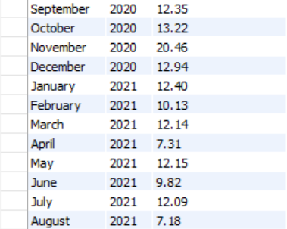
Get the complete report of the gross sales amount for the customer “Atliq exclusive” for each month. this analysis helps to get an idea of low and high-performing months and take strategic decisions. the final report contains these columns: month, year, gross sales amount
SQL-Input
SELECT
monthname(fsm.date) as Month, year(date) as Year, Round(sum(sold_quantity*gross_price/1000000),2) as Gross_Sales_Amount
from fact_sales_monthly fsm
join dim_customer dc
on fsm.customer_code=dc.customer_code
join fact_gross_price fgp
on fgp.product_code=fsm.product_code and fgp.fiscal_year=fsm.fiscal_year
where customer="Atliq Exclusive“
group by fsm.date
order by fsm.date asc

Slide 17
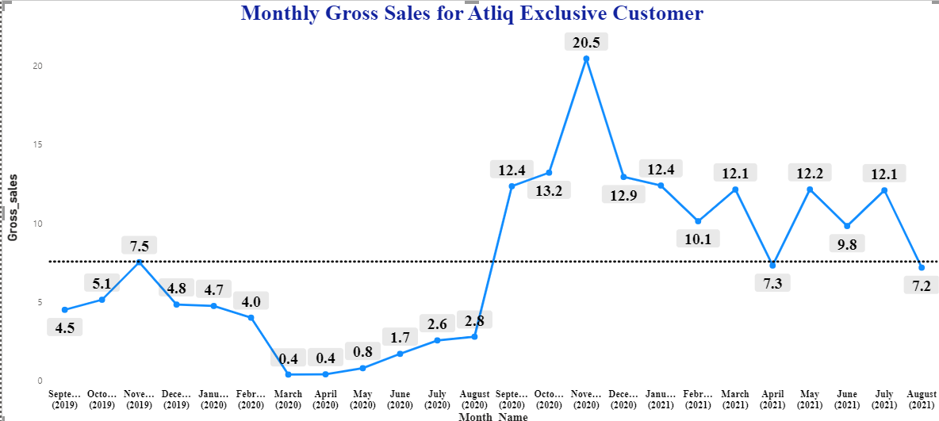
The lowest gross sales total for fiscal year 2020 is March(2020) and April 2020 and for fiscal year (2021) is august 2021& August 2021 The highest gross sales total for both fiscal years is in November(2021). In the fiscal year 2021 the gross sales total was not only high but it was consistently on a profit side.
FY 2020
Highest Gross Sales
20.5M
Lowest Gross sales
0.4M
FY 2021
Insights

Slide 18
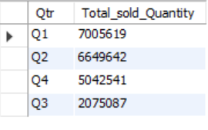
In which quarter of 2020, got the maximum total_sold_quantity? the final output contains these fields sorted by the total_sold_quantity, quarter total_sold_quantity.
SQL Input
with cte1 as
(select *,
Case
when Month in (9,10,11) then"Q1“
when Month in(12,1,2) then"Q2“
when Month in(3,4,5) then "Q3“
else "Q4“
End as Qtr
from (SELECT*,month(date) as Month FROM fact_sales_monthly) as new)
select Qtr, sum(sold_quantity) as Total_sold_Quantity
from cte1
where fiscal_year="2020“
group by Qtr
order by Total_sold_Quantity desc
Output

Slide 19
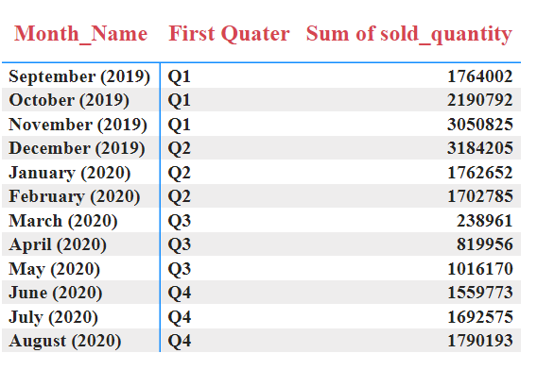
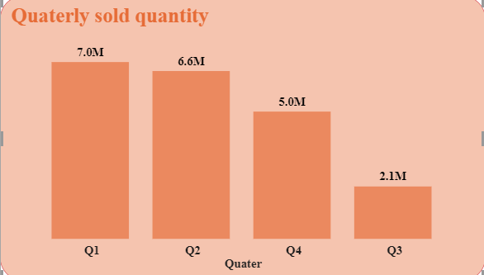
Insights
. Q1 of FY 2020 saw the most units sold overall, while Q3 had the fewest.
. The highest and lower overall sold quantity is in December and March.
. Q1 accounts for approximately 34% of the total sold quantity for FY2020.

Slide 20
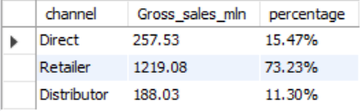
Which channel helped to bring more gross sales in the fiscal year 2021 and the percentage of contribution? the final output contains these fields channel , gross_sales_mln, percentage.
SQL- Input
with cte1 as
(SELECT dc.channel,
round(sum(sold_quantity*gross_price)/
1000000 ,2)as Gross_sales_mln
FROM fact_sales_monthly fsm
join fact_gross_price fgp
on fsm.product_code=fgp.product_code and
fsm.fiscal_year=fgp.fiscal_year
join dim_customer dc
on fsm.customer_code=dc.customer_code
where fsm.fiscal_year=2021
group by dc. Channel)
select channel, Gross_sales_mln, concat(round((Gross_sales_mln*100)/
sum(Gross_sales_mln) over(),2),”%” )as percentage
from cte1
Output

Slide 21
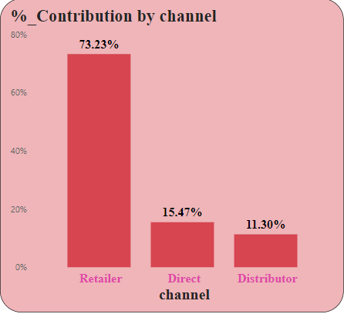
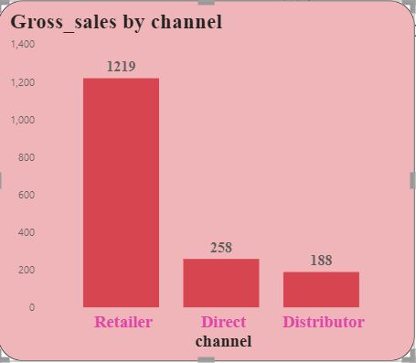
Channel “Retailer” helped bring maximum sales to the company with 73.22% as the contribution percentage. Channel “Distributor” makes the least contribution at a percentage of 11.30%
Insights

Slide 22
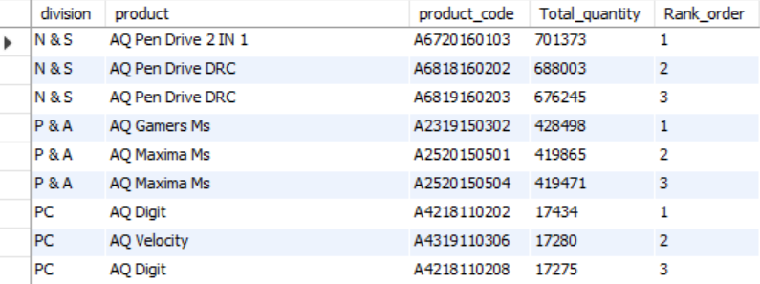
Get the top 3 products in each division that have a high total_sold_quantity in the fiscal_year 2021? the final output contains these fields division product_code, product ,total_sold_quantity rank_order
SQL-Input
with cte1 as
(select division, dm.product, dm.product_code, sum(sold_quantity)as Total_quantity
from fact_sales_monthly fsm
join dim_product dm
on fsm.product_code=dm.product_code
where fiscal_year=2021
group by dm.product_code, division, product),
cte2 as
select *,dense_rank() over(partition by division order by Total_quantity desc) as Rank_order from cte1)
select* from cte2 where Rank_order<=3
Output

Slide 23
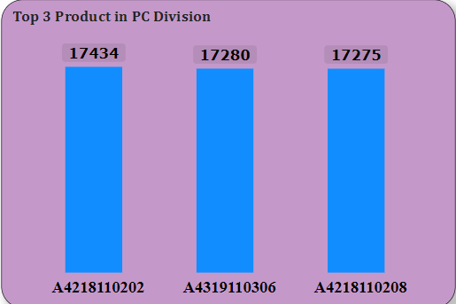
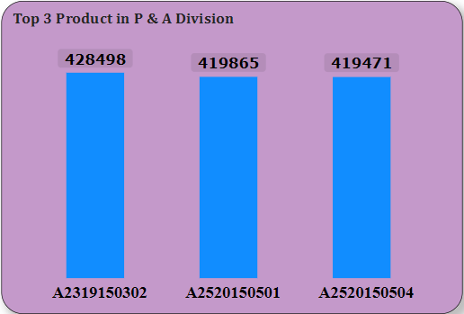
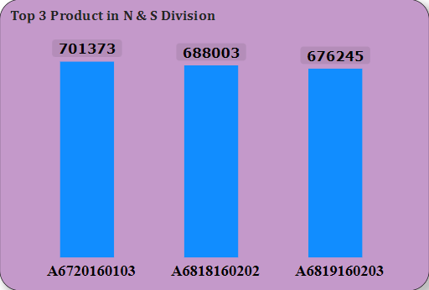
Every division has a product with different variants that appears twice in the top three products by division list.
AQ Digit
AQ Velocity
AQ Digit
AQ Gamers MS
AQ Maxima MS
AQ Maxima MS
AQ Pen Drive 2 in 1
AQ Pen Drive DRC
AQ Pen Drive DRC
Insights

Slide 24
Thank You Mr. Dhaval Patel sir & Mr. Hemanand Vadivel sir
For giving us the real data sets and the opportunity to practice and improve our skills .
Thank you sir!!!

